Slide 1
Lecture 2 – Introduction to Cross Platforms
Mr. Yousif Garabet Arshak
Computer Science Department
University of Zakho
yousif.arshak@uoz.edu.krd

Slide 2
Outlines
What is Cross Platform
Why Using Cross Platform
Cross Platform vs Native Platform
Available Cross Platforms
What is Suitable Cross Platform for us and Why

Slide 3
What is Cross Platform
A cross-platform computer product or system is a product or system that can work across multiple types of platforms or operating environments. Different kinds of cross-platform systems include both hardware and software systems, as well as systems that involve separate builds for each platform, as well as other broader systems that are designed to work the same way across multiple platforms.
Cross platform is also known as multiplatform or platform independent.

Slide 4
Why Using Cross Platform
1- It reduced overall Mobile application development Cost and Expenses
Cross-platform offers flexibility where we do not need to develop applications in multiple languages. Apart from that software testing and debugging becomes very easy, as bugs identified in the common code base need to be tested and fixed at once. Hence, it helps us reduce the cost, effort and time invested on application development, which in turn reduces the cost up to great extent.

Slide 5
2- Single Codebase
This approach allows us to write a single and universal code, which essentially covers different frameworks, mobile operating systems at once. Single codebase influences and enhances all the stages of mobile app development, as it allows us to code less and invest fewer resources for debugging and fixing only a single code, instead of working on separate codes.
3- Reduction in Time to market
Time to market is an extremely important metric for application development. Cross-platform allows developers to develop a universal application for multiple platforms, instead of developing 2-3 separate applications for each device platform. It ensures we can release our application in the market at a rapid pace.

Slide 6
4- Uniformity Across Different Platforms
Cross-platform enhances uniformity across different operating systems and offer a seamless user experience.
5- Reachability to more customers and better ROI
Cross-platform applications help Organizations to reach and engage more customers and it in turn increases the user experience and future Return on Investment.
6- Tool familiarity
The Cross-platform application development tools are quite familiar for developers, as they employ commonly used programming languages. These languages and tools are easy to learn and use.

Slide 7
7- Ideal for Prototyping
Cross-platform mobile application development is ideal for developing application prototypes, as it allows a rapid time to market on multiple platforms. It also offers an opportunity to interact with the customers, take their feedback, create a niche in the market, and secure the patents before any competitor can capture that opportunity. Hence, it gives a much needed tactical and strategical push to the mobile application owner.
8- Enterprise-wide Deployment and Adoption
Cross-platform gives a big advantage to the Enterprises if they want to deploy the applications for usage by their employees. Cross-platform can help you deploy the application at an unbelievable pace and it also helps to adopt the applications at a much lower cost, since BYOD (bring your own device) policies are becoming a new norm at the workplace.

Slide 8
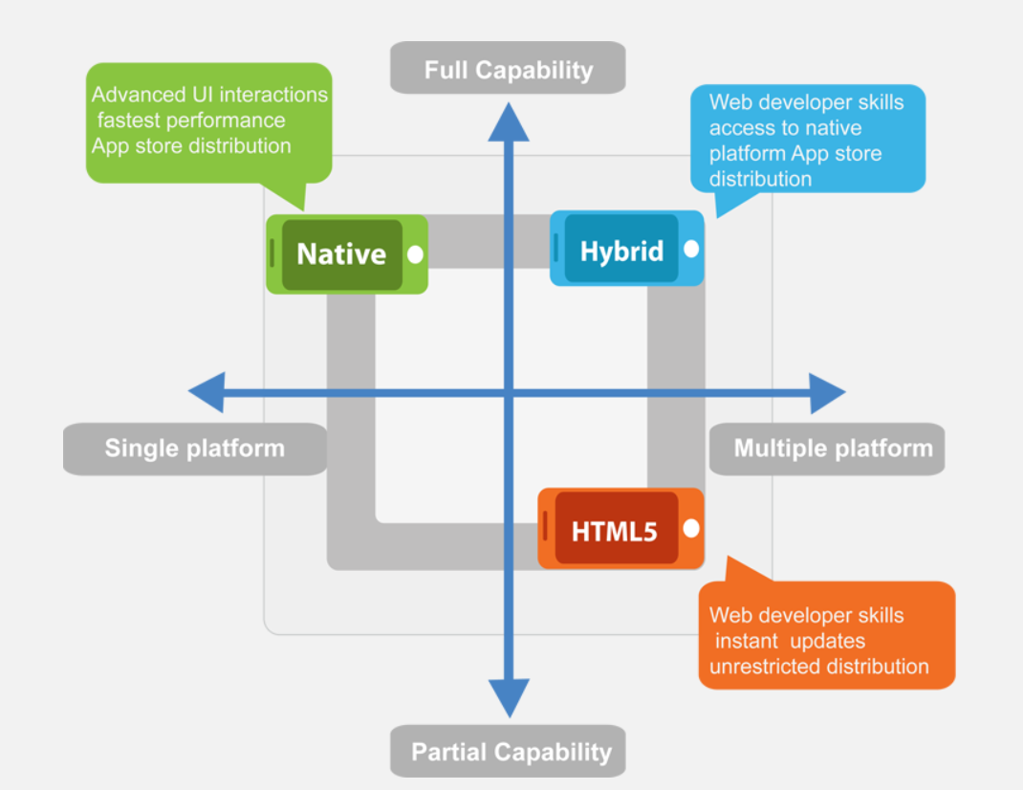

Slide 9
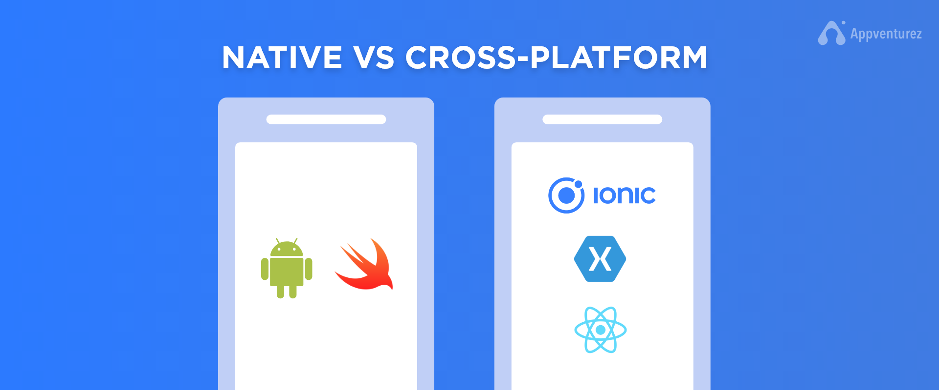
Cross Platform vs Native Platform

Slide 10
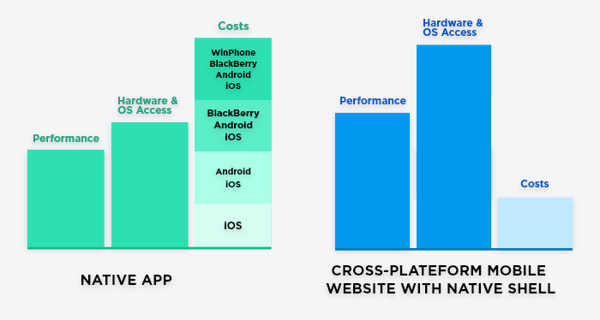

Slide 11
Advantages of Native Apps Development | Advantages of Cross-Platform Apps Development
Better Performance | Reduction in Development Time and Cost
Platform In-Synced User Experience | Easier Support and Maintenance
Easier Integration | Greater User Base Exposure
Greater Support of Development Tools | Lesser Resource Requirement
Drawbacks of Native App Development | Drawbacks of Cross-Platform App development
Greater Development Time | Poor Performance
Higher Developmental Cost | Lesser Access to Device’s Features
Greater Resource Requirement

Slide 12
Available Cross Platforms
Over the last year or so the market for enterprise-ready mobile cross platform development has actually started to take-off
Large and medium sized companies are progressively adjusting to the mobile world and realising the need to provide tablet computer and smartphone access to their line-of-business applications.
The demand for the capability to quickly develop and deploy applications at a large scale means cross platform development tools will be really important over the coming years.

Slide 13
SENCHA
Sencha is a tool that lets you develop your apps in HTML5
PHONEGAP2
PhoneGap Owned by Adobe, PhoneGap is a complimentary resource that newbie app developers could use to translate code from HTML5, CSS, and JavaScript.
TITANIUM STUDIO3
Appcelerator Titanium Using JavaScript, Titanium’s SDK produces indigenous iOS and Android applications while reusing anywhere from 60 % to 90 % of the same code for all the apps you make,

Slide 14
COCOS2D4
Cocos2dCocos2d is primarily used in two-dimensional game development. It gives developers the option of 5 different forks or platforms to develop on.
UNITY 3D
Unity 3D is a game engine you can use if you really want to take care of your incredible graphics. It goes beyond being a basic translation tool. After establishing your code in UnityScript, C#, or Boo, you could export your games to 17 different platforms, including iOS, Android, Windows, Web, Playstation, Xbox, Wii and Linux.Once you’ve got your game on all your selected platforms, Unity will also assist you distribute it to the appropriate stores, obtain social shares, and track user analytics.

Slide 15
CORONASDK
It’s another cross platform mobile development tool that’s optimized for 2D gaming graphics and helps you make games.Corona’s programming language is Lua, which is written in C, making it a cross platform language. Corona chose Lua because they found it to be really robust with a small footprint for mobile apps.
QT
Qt is a subscription-based service that lets you code in C++, and then export your app to the different platforms on which you intend to develop.Once the apps are exported, the Qt interface lets you access your apps on their respective platforms and devices, so you can see how well the app is operating and make changes if and where needed.The best part? You don’t need to own many different devices for testing.

Slide 16
ALPHA ANYWHERE
Alpha Anywhere is a tool that gives the developer several options when it involves programming languages, consisting of: C#, JavaScript, Xbasic, VB.NET, or any type of other.NET supported language like Cobra and C++. The site offers step-by-step walkthrough video tutorials to help first-time app developers make certain they’re getting everything right, but it does come with a pretty hefty price tag.
5APP
5App concentrates on data security while using HTML5 and JavaScript coding to export apps to Android and iOS. The only downside is they require you to get in contact with them prior to you get started using their platform, but they promise productivity and ease of use once you do.

Slide 17
Flutter
Flutter is Google’s mobile app SDK which allows developers to write apps for iOS and Android using the same language and source code. With Flutter, developers can build native like apps using Dart programming language and using its own widgets. Being backed by Google, Flutter is emerging as strong competitors for the Xamarin and React Native. Flutter uses Dart programming language which was introduced by Google in 2011 and is rarely used by developers.
React Native
React Native is a cross-platform mobile app development framework created by Jordan Walkie, a Facebook software engineer. In 2015, React Native became an open-source project.

Slide 18
XAMARIN
With a totally free starter option, Xamarin is a mobile development tool that includes app store delivery, performance testing and monitoring, and the ability to do virtual tests on more than 1,000 devices making sure everything is working and showing like it should. Using Ruby or C# for code, Xamarin has created a robust cross platform mobile development platform that’s been adopted by big names like Microsoft, Foursquare, IBM, and Dow Jones.

Slide 19
What is Suitable Cross Platform for us and Why
In this course we will be using Xamarin Forms because of some reasons:
Code Sharing, or ‘Write Once, Use Everywhere’
Support and Full Technical Backing by Microsoft
Flexibility of C# and .NET
Minimal Time to Market
Native Performance and Integration
Xamarin IDE is Visual Studio

Slide 20
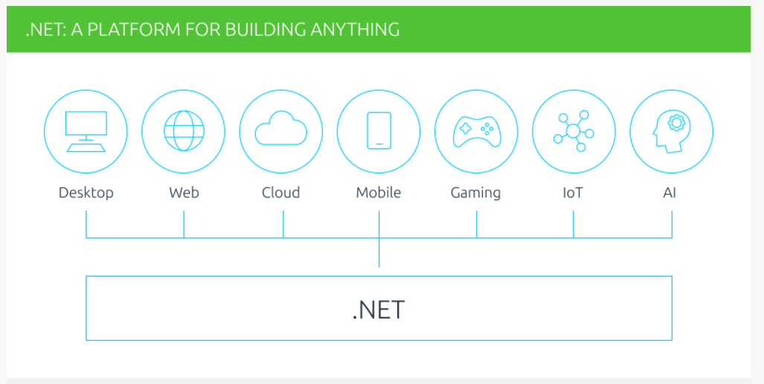

Slide 21
Group Discussion
Do you believe cross platform or native platform is better for creating apps and why?

Slide 22

Any Questions?

